Slide 1
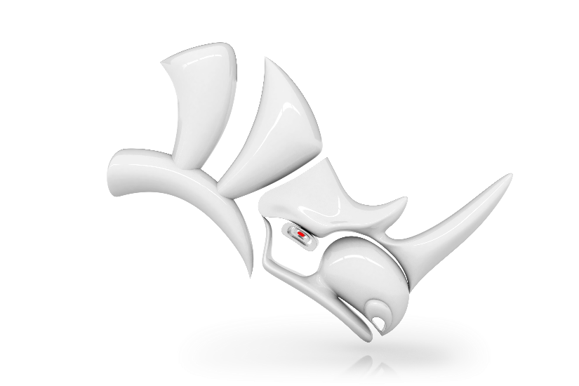

Choose the offer best suited
to your environment
Scalable single license
4 affordable bundles
BIM : Import IFC, Navisworks, Revit files
Export of Rhino models to the following formats: CATIA V4, CATIA V5, CGR, FBX, glTF, JT, NX, Parasolid, PDF 3D, SolidWorks
Import Rhino parts or assemblies designed with: ACIS, CATIA V4, CATIA V5, CATIA V6, CGR, Creo View, Fusion 360, Inventor, JT, Navisworks, Parasolid, PLM XML, ProE / Creo Parametric,
Solid Edge, UG NX
Export + Import
Fixed or floating license
run on a computer or a server
Perpetual license purchase
online or to your Rhino reseller
Windows 7 / 8 / 10 / 11 (64 bits) compatible
SOLUTIONS TO EXCHANGE
RHINO DATA
Read and write plug-ins
for Rhino V6, 7, 8
READ: ACIS / CATIA V4 3D / CATIA V5 3D /
CATIA V6, 3DEXPERIENCE / CGR / Creo View /
Fusion 360 / IFC / Inventor / JT / Navisworks /
Parasolid / PLM XML / ProE, Creo Parametric 3D /
Revit / Solid Edge 3D / UG NX 3D
WRITE: CATIA V4 3D / CATIA V5 3D / CGR /
FBX / glTF / JT / Parasolid / PDF 3D /
SOLIDWORKS 3D / UG NX 3D
Discover also our plug-ins
for SolidWorks and
our stand-alone convertors.
Visit our web site!

Slide 2

Choose the offer best suited
to your environment
Scalable single license
4 affordable bundles
BIM : Import IFC, Navisworks, Revit files
Export of Rhino models to the following formats: CATIA V4, CATIA V5, CGR, FBX, glTF, JT, NX, Parasolid, PDF 3D, SolidWorks
Import Rhino parts or assemblies designed with: ACIS, CATIA V4, CATIA V5, CATIA V6, CGR, Creo View, Fusion 360, Inventor, JT, Navisworks, Parasolid, PLM XML, ProE / Creo Parametric,
Solid Edge, UG NX
Export + Import
Fixed or floating license
run on a computer or a server
Perpetual license purchase
online or to your Rhino reseller
Windows 7 / 8 / 10 / 11 (64 bits) compatible
SOLUTIONS TO EXCHANGE
RHINO DATA
Read and write plug-ins
for Rhino V6, 7, 8
READ: ACIS / CATIA V4 3D / CATIA V5 3D /
CATIA V6, 3DEXPERIENCE / CGR / Creo View /
Fusion 360 / IFC / Inventor / JT / Navisworks /
Parasolid / PLM XML / ProE, Creo Parametric 3D /
Revit / Solid Edge 3D / UG NX 3D
WRITE: CATIA V4 3D / CATIA V5 3D / CGR /
FBX / glTF / JT / Parasolid / PDF 3D /
SOLIDWORKS 3D / UG NX 3D
Discover also our plug-ins
for SolidWorks and
our stand-alone convertors.
Visit our web site!

Slide 3
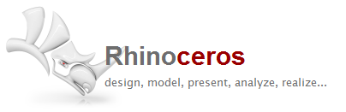
Choose the offer
best suited to your environment
ACIS / CATIA V4 3D / CATIA V5 3D / CATIA V6, 3DEXPERIENCE / CGR / Creo View / FBX / glTF / Fusion 360 / IFC / Inventor / JT / Navisworks / Parasolid / PLM XML / ProE, Creo Parametric 3D / Revit / SolidEdge 3D / SolidWorks 3D / UG NX 3D
Scalable single license
4 attractive bundles
BIM : Import IFC, Navisworks, Revit files
Export of Rhino models to the following formats: CATIA V4,
CATIA V5, CGR, FBX, glTF, JT, NX, Parasolid, PDF 3D, SolidWorks
Import Rhino parts or assemblies designed with: ACIS, CATIA V4, CATIA V5, CATIA V6, CGR, Creo View, Fusion 360, Inventor, JT, Navisworks, Parasolid, PLM XML, ProE / Creo Parametric, Solid Edge, UG NX
Export + Import
Fixed or floating license
run on a computer or a server
Perpetual license purchase
online or to your Rhino reseller
Windows 7 / 8 / 10 / 11
(64 bits) compatible
Discover also our plug-ins
for SolidWorks and
our stand-alone
convertors.
SOLUTIONS TO EXCHANGE
RHINO DATA
Read and write plug-ins
for Rhino V6, 7, 8
90 avenue Félix Faure
69001 Lyon - FRANCE
solutions@datakit.com
www.datakit.com

Slide 4
Exploit any 2D
and 3D technical data
Opt for efficiency
By installing the plug-in, a menu is added to Rhino.
Thus, directly from this menu,
you will perform any models import or export operations in the format you have chosen.
Fast and complete data processing.
Filter data any way you choose.
Quarterly updates = perfect compatibility with the latest versions of CAD software.
The converters enable designers to read files not natively compliant with Rhino and to store files different from
the Rhino ones.
Linear and angular dimensions
3D B-rep,
Mesh representation,
Parts / assemblies / attributes
(colors, textures, …)
Product Manufacturing Information:
PMI / FD&T / GDT,
Metadata, properties
Facilitate interoperability
Subcontracting,
Collaborative working,
Multi-format design,
Heterogeneous supply-chain
environment,
Long-term archiving,
Quality control, measurement,
Design, Production engineering,
prototyping.
World wide
resellers network
DATAKIT, international
technological partner
For a long time Datakit works in close relationships with several Rhino resellers
who propose its technical exchange
data in lots of countries.
Consult the list of our resellers
or contact us solutions@datakit.com
30 years' of data exchange experience.
High qualified R&D and technical
support teams.
.
French company with a resolutely
international outlook.
Technology integrated by numerous software editors and industry professionals.
.

